Slide 1


May 15, 2014
Suitability, Know Your Customer and You.

Slide 2
Introductions
Morris Simkin Morrie is an experienced and knowledgeable corporate and securities lawyer. After serving as Special Counsel with the SEC’s Divisions of Enforcement and Trading and Markets in Washington, D. C. he moved to New York. There he has been associated with, counsel to or a partner of several major and well known law firms, before establishing his own firm. His clients include public and private companies, broker-dealers whom he counsels as to permitted activities and handles SEC and FINRA inspections, investigations and enforcement actions, investment advisers, hedge funds and mutual funds.
Keith Pyke is a product manager for MySuitabilityOffice at TerraNua.
TerraNua provides compliance automation tools to investment adviser, broker dealer and asset management clients worldwide. TerraNua’s main solutions are :
  MyComplianceOffice -Conflict of interest and compliance program management automation.
  MySuitabilityOffice- Suitability and ‘know your customer’ automation.
  MySurveillanceOffice- Trade and portfolio surveillance automation.
Michelle Inferri is a sales director at TerraNua.

Slide 3
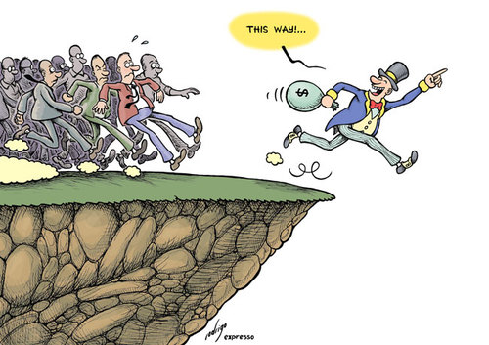
This Way

Slide 4
Know Your Customer, FINRA Rule 2090
Know the essential facts in opening a customer’s account
a. The facts necessary to service the account
b. Who has authority over the account
c. Any special handling instructions
d. Comply with applicable law

Slide 5
Suitability FINRA Rule 2111
Simple Concept, but extremely complex application
FINRA has published five Regulatory Notices to explain it ( 11-02; 11-25; 12-25; 12-55;
and 13-31), a FAQ and a sample account opening form

Slide 6
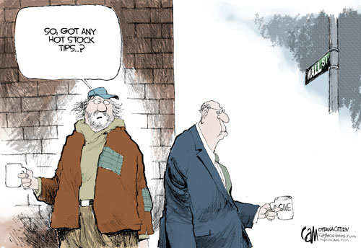
So Got Any Hot Stock Tips

Slide 7
Suitability Obligation
Suitability obligation applies whenever a broker recommends
a transaction or investment strategy to a customer based upon the customer’s
investment profile
4 key terms that must be defined

Slide 8
Customer
Anyone who has an account with the broker or effects a transaction with a
broker– either directly or where the broker receives compensation because the
customer effected a transaction
e.g. a private placement where broker is acting as placement agent
And the broker recommended the transaction, investment strategy or
that the customer hold a security
Example: you send research and recommend a security to a friend, and (s)he later
effects a trade in that security with you; but she is not a customer if (s)he effects
the trade elsewhere

Slide 9
Recommend
This is a facts and circumstances test
Did the content, context and presentation of a communication or series of
communications involve a call to action or suggest that the customer engage
in a security transaction?
It also includes an affirmative recommendation to hold a security
or to follow a specific investment strategy

Slide 10
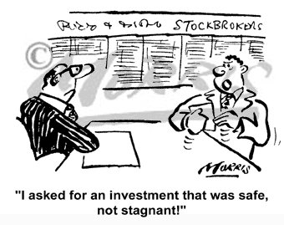
Recommendation

Slide 11
Implicit Recommendations
Implicit recommendations are recommendations triggering a suitability obligation
Effecting a transaction pursuant to discretionary authority or without first
informing the customer are implicit recommendations

Slide 12
Investment Strategies
Investment Strategy
Any strategy involving the purchase, sale or holding of a security
includes: trade on margin, day trading, using a home equity loan to
fund trading in securities
Includes a mix of strategies that include trading in securities– e.g.
buy a futures and sell a security

Slide 13
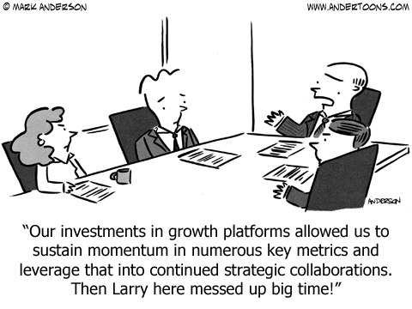
Investment Strategies

Slide 14
Investment Profile
Investment Profile
Customer’s Age
Other Investments
Financial Situation and Needs
Tax Status
Investment Objectives
Investment Experience
Investment Time Horizon
Liquidity Needs
Risk Tolerance
Information Investor Supplies

Slide 15
The three Tests of Suitability
The 3 tests of suitability
Reasonable basis
Customer specific recommendation
Quantitative suitability
FINRA has stated a fourth test that the recommendation does not favor the
broker over the customer

Slide 16
Reasonable Basis
Based upon reasonable due diligence has reasonable basis to
believe that the security or investment strategy is suitable for at least
some customers
Reasonable basis
the broker him/herself understands the security,
its risks and rewards
it is not enough for the security to be
approved by the firm if the individual
broker does not also understand the security/strategy

Slide 17
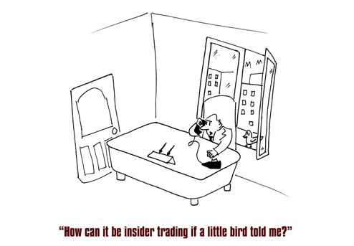
How Can it be Insider Trading?

Slide 18
Customer Specific
The broker has obtained or used reasonable diligence to obtain the
customer’s investment profile, and, based thereon, has a reasonable
basis to believe that the recommendation is suitable for the specific
customer

Slide 19
Quantitative Specific
The broker with actual or de facto control over a customer account has a
reasonable basis to believe that a series of recommended transactions, even if
suitable when viewed in isolation, are not excessive or unsuitable for the
customer when taken together in light of the customer’s investment profile

Slide 20
Reasonable Diligence
Broker uses reasonable diligence when (s)he asks the customer for the
information (and documents the request and reply)
The rule imposes no duty to update, except to the extent the customer gives
the broker new information
But SEC Rule 17a-3(a)(17) imposes a duty to update a natural person’s
information every 3 years
If the request for information is not clear or the customer shows an
inability to understand or reply or there are other “red flags” the broker
has not exercised reasonable diligence

Slide 21
Customer Fails or Refuses to Supply
If one or more items of the customer profile are missing, broker can not act
on the basis of any assumptions or impressions (s)he has about the customer
regarding the missing item
Broker can make a risk based assessment of the need for the missing
information in order to determine a recommendation’s suitability

Slide 22
Customer Financial Ability
Can’t recommend a transaction or investment strategy to a customer
unless you have a reasonable basis to believe that the customer has
the financial ability to meet such commitment.

Slide 23
The Broker has an Obligation to Work in the Customers Best Interest
The suitability rule requires the broke to make only those recommendations
that are consistent with the customer’s best interest
It prohibits a broker from placing his or her interests ahead of the customer’s
Interest
you can’t place your self-interest ahead of the customer’s
no switching to generate commissions
no favoring one product over a similar because it pays a
higher commission
no churning

Slide 24
Institutional Investor Exemption
Over $50m in assets
Broker reasonably believes his client is capable of independent judgment
Customer affirmatively indicates it is exercising independent judgment

Slide 25
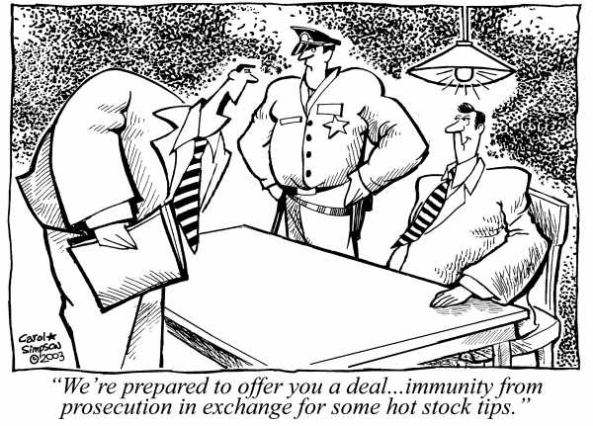
Q&A

Slide 26
How MySuitabilityOffice Can Help
How MySuitabilityOffice Can Help

Slide 27
Typical Customer Suitability Rules
Clients / Households
  Investment Objectives, Investment Experience, Time Horizon, Income Tax, Country, Employment, Age
Accounts
  Suitability to Portfolio Model
  Risk Tolerances
Cash Movements
  Large Deposits/Withdrawals
  Frequency
Trades
  Turnover
  Frequency
  Commissions
Holdings
  Per cent holdings in different security classifications
  Plus all data quality checks on whether data is complete (address, suitability data, account data)

Slide 28

Overview Slide of Suitability Components
Client Information
Daily Data Capture and/or Manual Maintenance into My Compliance Office
Household
(if applicable)
Clients
Compliance
Client Accounts
Rules
Trans-actions,
Holdings and Account Values
Alerts
Firm Products / Portfolio Models
Overrides

Slide 29
Contact Details
Morris N. Simkin
Simkin Law Office
51 E. 42d Street
New York, New York 10017
msimkin@securitiesregslawyer.com
212 455 0476
Michelle Inferri
212-852-9029
minferritauss@terranua.com
www.MySuitabilityOffice.com

